Slide 1




GOLD PRICE
PREDICTION
BY: AAKASH JAMWAL

Slide 2

PROBLEM STATEMENT:
This project aims to leverage a comprehensive dataset of daily gold prices spanning from January 19, 2014, to January 22, 2024, obtained from Nasdaq. The dataset encompasses key financial metrics for each trading day, including the opening and closing prices, trading volume, as well as the highest and lowest prices recorded during the day.
OUR GOAL:
The main goal of the project is to analyze daily gold prices over a ten-year period, using key financial metrics such as opening and closing prices, trading volume, and highest and lowest prices. This analysis aims to identify trends, patterns, and factors influencing gold prices, and develop predictive models for forecasting future gold prices

Slide 3
FEATURES:
Date: A unique identifier for each trading day.
Close: Closing price of gold on the respective date.
Volume: Gold trading volume on the corresponding date.
Open: Opening price of gold on the respective date.
High: The highest recorded price of gold during the trading day.
Low: The lowest price recorded for gold in the trading day.
TARGET VARIABLE:
Close: Closing price of gold on the respective date.

Slide 4

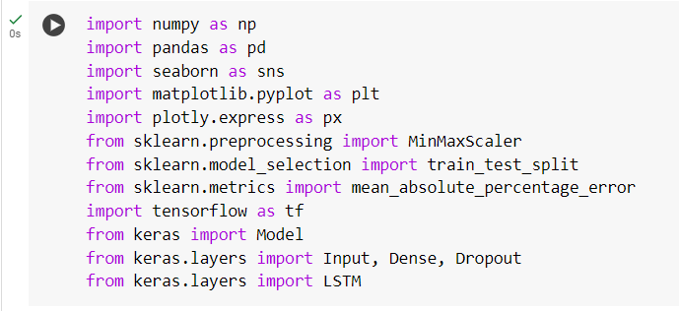
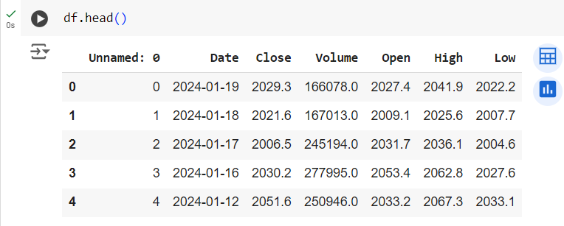
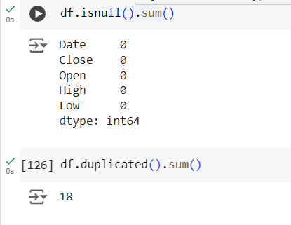
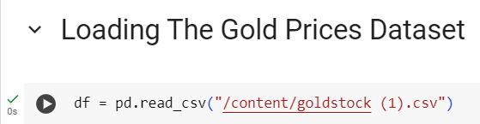
DATA PREPROCESSING:
Imported necessary tools and library and loaded dataset by using pandas. Perform data cleaning activity by Checking missing values, remove irrelevant column.

Slide 5
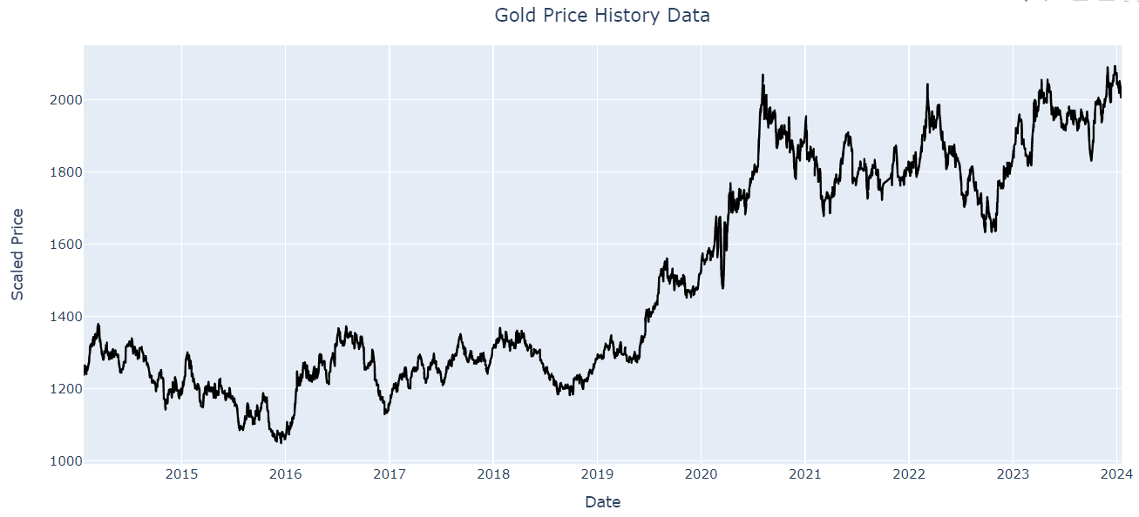
CLOSE PRICE OF GOLD OVER THE PERIOD

Slide 6
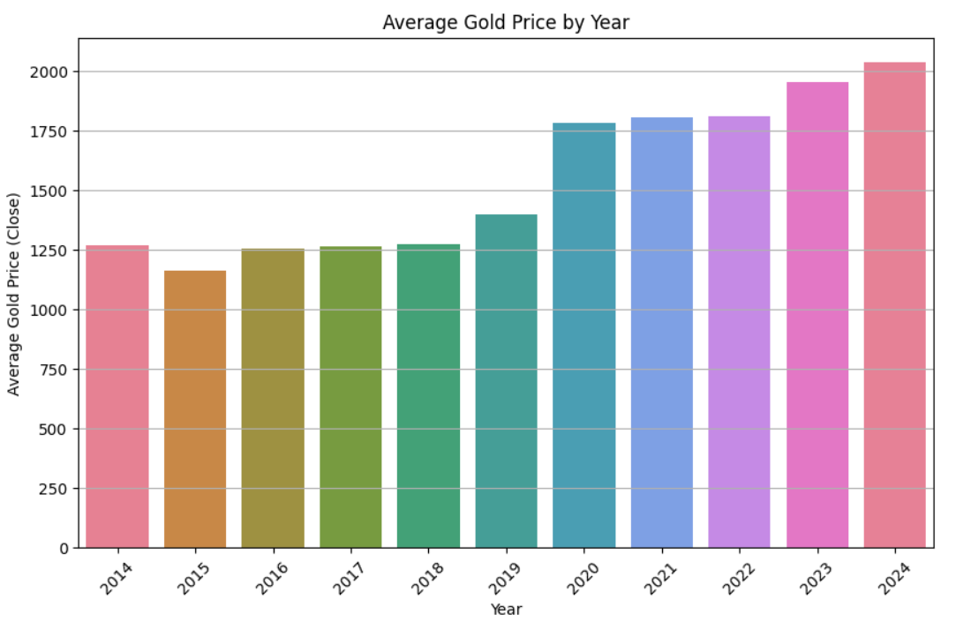
YEARLY TIME ANALYSIS:
Yearly : Gold price are raising by time

Slide 7
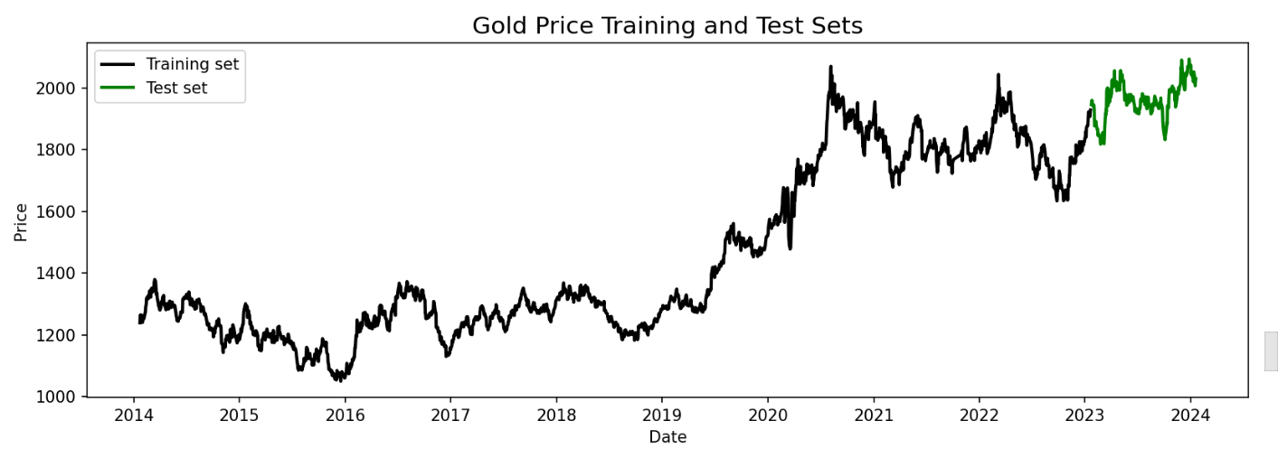
TRAINING AND TESTING SET:

Slide 8
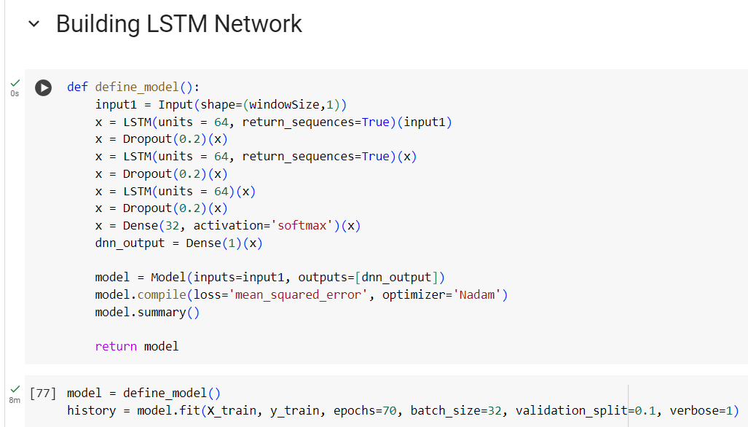
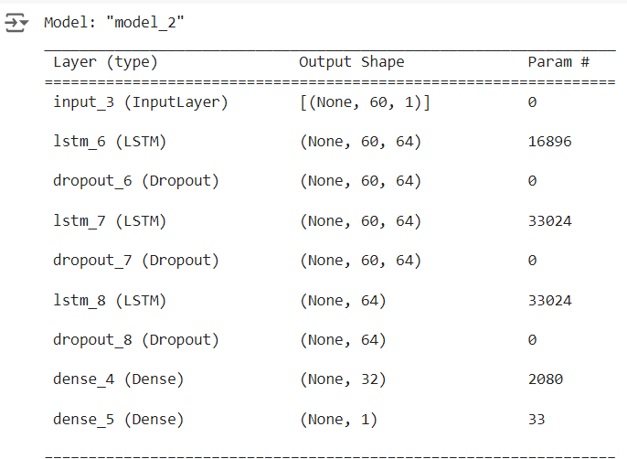
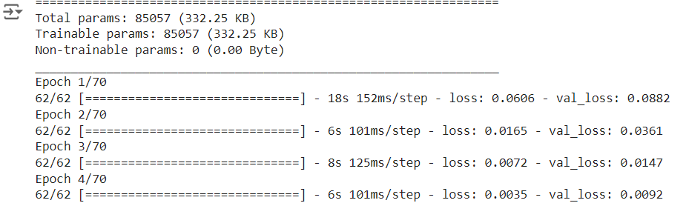

Slide 9
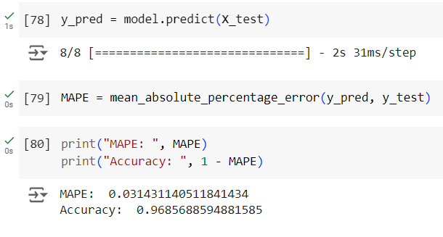
EVALUATING THE MODEL:

Slide 10
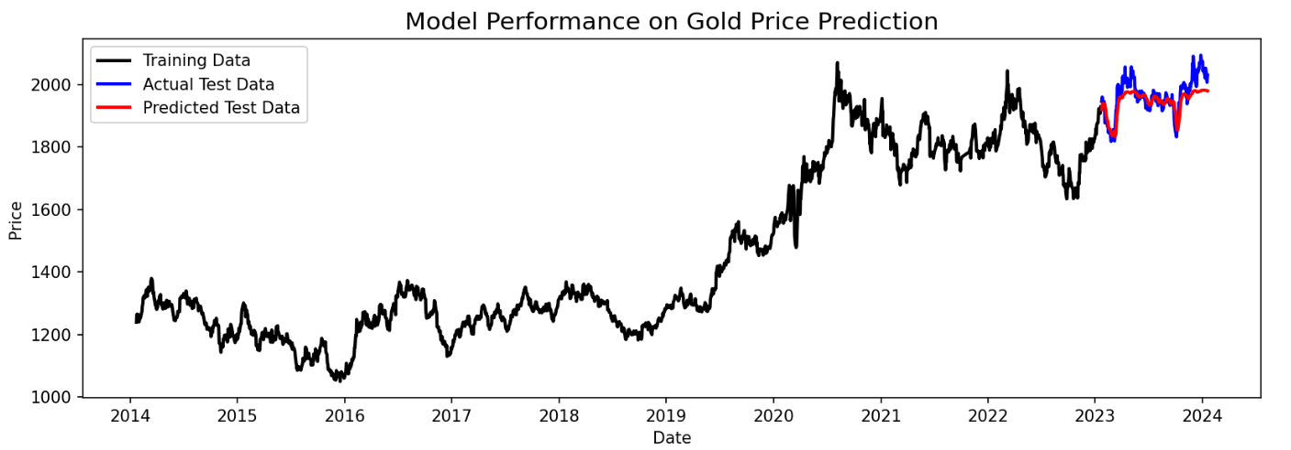
RESULT:

Slide 11
CONCLUSION:
The project offers actionable insights and strategies for investors to navigate gold markets effectively. By leveraging advanced analytics and machine learning techniques, investors can make informed decisions and enhance their financial performance in volatile market conditions.

Slide 12

THANK YOU

